Slide 1
Subject Name : Wireless Communication Presentation Title: Wireless Communication Technologies
JEPPIAAR INSTITUTE OF TECHNOLOGY
“Self-Belief | Self Discipline | Self Respect”
Department of Electronics and communication Engineering
Team Members:
Students Name Reg.No:
1. NIVETHA T 210617106056
2. KAYALVIZHI P 210617106048
3. RAJA SINDHIYA 210617106067
4. PRABAKARAN V 210617106057
5. PRADEEP B T 210617106058
6. LOGA PAVITHRAN S 210617106051

Slide 2
Objective
To Design/ Analyze/ Evaluate
Right from the Bluetooth to Wi-Fi LANs and MANs to the satellite communication, the wireless networks hold these on.
Wide spread applications and services- video conferencing, telemedicine, distance learning, and much more.
An umbrella term that includes any communication device or application.

Slide 3
Technical Details
CDMA
Code Division Multiple Access.
Uses spread spectrum techniques.
Data is sent in small pieces over a number of discrete frequencies.
Unique spreading code.
Greatest advantage- doesn’t assign a single frequency to user.
Secured transmission.

Slide 4
BLUETOOTH
A wireless technology standard for exchanging data over short distances. Any data or information can be transmitted faster and with a high speed.
Using short-wavelength UHF radio waves in the ISM band from 2.4 to 2.485 GHz.
The IEEE standardized Bluetooth as IEEE 802.15.1

Slide 5
BLUETOOTH COMMUNICATION
Bluetooth uses a radio technology called frequency-hopping spread spectrum.
Bluetooth is a packet based protocol with a master-slave structure.

Slide 6
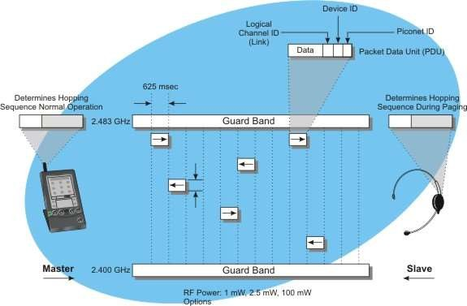
BLOCK DIAGRAM

Slide 7
GPRS
General Packet Radio Service is a packet based wireless communication service that permits data rates from 56 kbps and 114 kbps and continuous connection to the Internet for mobile phone and computer users.

Slide 8
GENERATION
Each generation of data network gets faster. We saw 2G (second generation) from 1999, 3G (third generation) from 2001 and started seeing 4G (fourth generation) in 2012.
GPRS,2G,3G,4G are all indicators of signal strength for downloading and uploading data.

Slide 9
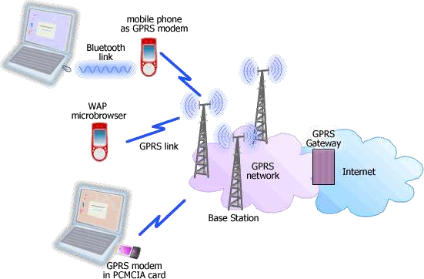
HOW GPS WORKS?

Slide 10
WI-FI
Wi-Fi (Wireless Fidelity) is a generic term that refers to IEEE 802.11 standard for Wireless Local Area Networks (WLANs).
Wi-Fi Network connect computers to each other, to the internet and to the wired network.

Slide 11
Application of Wi-Fi
Companies use Wi-Fi to create wireless networks within their company.
Phone companies such as use Wi- Fi Hot Spots for their users to get free calling/internet access.
Gaming companies like Nintendo use Wi-Fi to synch their products and to use global network usage
RESULT AND DISCUSSION
The main challenge related to secure time synchronization and routing have been surveyed.
It plays the major role in many application area that are not possible in past.

Slide 12
REFERENCES
1.Franconi, Nicholas G.; Bunger, Andrew P.; Sejdić, Ervin;
Mickle, Marlin H. (2014-10-24). "Wireless Communication in Oil and Gas Wells". Energy Technology. 2 (12): 996–1005.
doi:10.1002/ente.201402067. ISSN 2194-4288.
2.Biswas, S.; Tatchikou, R.; Dion, F. (January 2006)."Vehicle-to-vehicle wireless communication protocols for enhancing
highway traffic safety". IEEE Communications Magazine. 44 (1): 74–82. doi:10.1109/mcom.2006.1580935. ISSN 0163-6804.

